Slide 1
Lymph nodes
Stereotactic Ablative Radiotherapy (SABR/SBRT)
2nd GC SABR Contouring Workshop.
18th April 2020
Dr Luis AZNAR-GARCÍA
Clinical Oncologist Consultant
Brain Mets MDT and SRS Lead Clinician
SABR Oligometastases, HpB, Breast.
Honorary (Consultant) Assistant Professor.
Nottingham University Hospitals
GENESIS CARE UK SABR REFERENCE GROUP MEMBER and SRS LEAD CLINICIAN

Slide 2
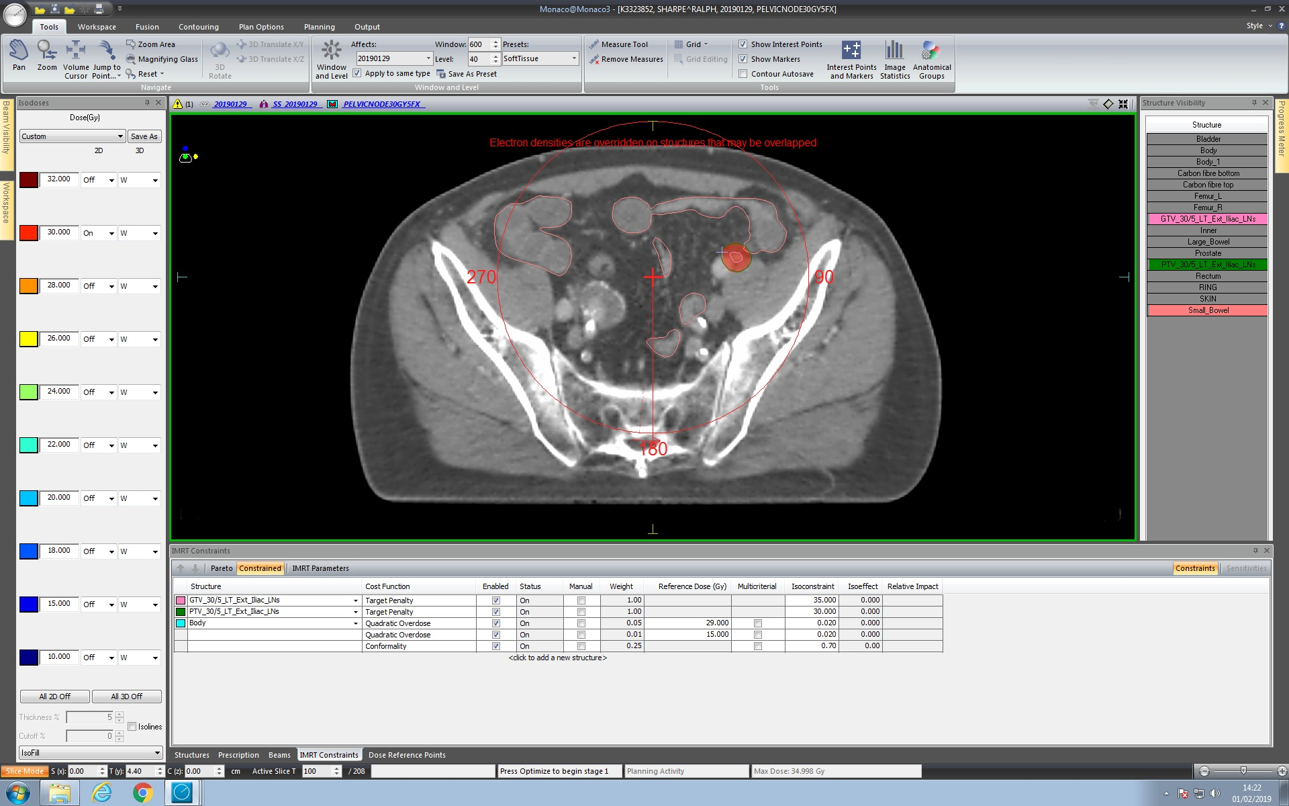
PATIENT SELECTION FOR SABR LNs
Patients should meet all the general oligometastatic eligibility criteria already mentioned.
⁽¹⁾ Stereotactic Ablative Radiotherapy (SABR): A resource. SABR UK Consortium. Version 5.1, January 2016.

Slide 3
PATIENT SELECTION FOR SABR LNs
EXCLUDED by CtE:
Patients who biologically require irradiation of a whole nodal field (e.g. supra- clavicular recurrence from breast cancer).
Abdominal lymph node metastases within 5mm of stomach/duodenum/small bowel will be challenging to treat safely to an ablative dose.
⁽¹⁾ Stereotactic Ablative Radiotherapy (SABR): A resource. SABR UK Consortium. Version 5.1, January 2016.

Slide 4
PATIENT SELECTION FOR SABR LNs
ALSO EXCLUDED:
Mediastinal LNs (due to bronchial tree).
When there could be infiltration of a ”tubular structure” and we could “die of success”.
If 2 LNs close together and when adding margin > 6 cm for technical reasons.
ALSO EXCLUDED (NO “GC simple SABR”):
Supraclavicular fossae (due to brachial plexus)
Upper abdomen (due to motion control and duodenal perforation).
Patients in whom there is overlap with previous radiation it should be considered in the re-irradiation (previous RT at the same axial level (coplanar techniques).

Slide 5
PEARLS AND PITFALLS WHEN OUTLINING/PRESCRIBING/DOSIMETRY/
IGRT SABR vs CFRT.

Slide 6
PEARLS AND PITFALLS
PATIENT PREPARATION AND REPRODUCIBILITY:
  To reduce bowel volume It could be helpful: >6 hs nil by mouth and low fiber diet before planning scan.
  Same conditions should be repeated for each #.
  There should be perfect matching every #.

Slide 7
TARGET VOLUMES OUTLINING
You treat (or you protect) what you outline and don't what you don’t outline.
The GTV should be outlined (Lymph Node).
No CTV margin: Node capsule is anatomical boundary (suspected broken capsule? Should or not treat them?
Small margin to create PTV (0.5 cm) from GTV=CTV.
PTV
GTV

Slide 8
OAR OUTLINING
2 cm
As mostly COPLANAR IMRT/VMAT SABR techniques will be used.
Therefore every potential organ which beams can traverse should be contoured. This may include lungs, heart, kidneys, liver, bowel, thyroid, larynx, chest wall, and oesophagus.
PEARL: we have to outline every OAR 2 cm above and below the PTV.
PTV
2 cm

Slide 9
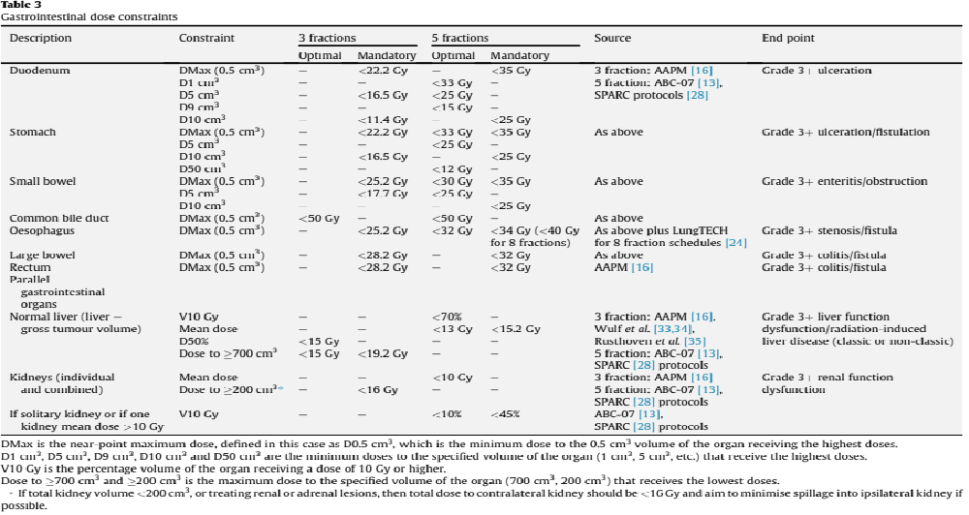
OAR CONTOURING AND CONSTRAINTS
⁽¹⁾ Guidelines: UK Consensus on Normal Tissue Dose Constraints for Stereotactic Radiotherapy. Hanna GG et al. Clinical Oncology 2017.

Slide 10
PEARLS AND PITFALLS
UNCERTAINTIES:
  WE NEED TO BE AWARE, UNDERSTAND AND KEEP UNDER CONTROL THE WHOLE PROCESS TO BE ABLE TO JUDGE AND, HENCE, PREVENT THE UNCERTAINTIES AND RISKS AND APPLY CORRECTIONS IN A TIMELY MANNER.
  Uncertanties: systematic vs random errors, image fusion, IGRT, outlining, planning…
  SAT MDT: ensures safety, advises re immobilization, patient preparation before during planning CT scan, IGRT…

Slide 11
SABR LNs dose/#
There is no consensus as yet for the optimal dose to lymph node metastasis.
The UK clinical experience is mostly based on 30 Gy in 3 fractions alternate daily, which appears efficacious and well tolerated (1).
This dose delivers a BED of 180 Gy for an alpha/beta of 2 Gy (e.g. prostate) but for an alpha/beta of 10 Gy delivers 60 Gy.
Patients for whom the a/b ratio is likely to be >6 Gy may benefit from careful dose escalation to 36-40 in 3 fractions (2) but the evidence base for this is less robust.
Rationale in prostate as well: Dose/local Control relationship in primary prostate: 36-40 Gy.
(1) Aitken K TA, Taylor H, Hawkins M, van As N. Stereotactic body radiation therapy for extra-cranial metastases – can we change the therapeutic paradigm? Paper presented at: NCRI2013; Liverpool.
(2) Jereczek-Fossa BA, Beltramo G, Fariselli L, et al. Robotic image-guided stereotactic radiotherapy, for isolated recurrent primary, lymph node or metastatic prostate cancer. Int J Radiat Oncol Biol Phys. Feb 1 2012;82(2):889-897.

Slide 12
COVERAGE/CONSTRAINTS/DOSE COMPROMISE
  WHEN CONSTRAITS NOT MET:
  You accept either reducing coverage to keep OAR constraints (I try to compromise only PTV and never, if possible, ITV/CTV and NEVER GTV.
  Or either decrease D per # and increase number of #.
  Dose/prescription paradigm shift (more true for SRS): In CFRT (ie lung 55/20): you prescribe doses and if not achieved constraints you don’t go ahead (change to palliative…) but in SABR you can reduce doses (spine: 27/3, -> 24/3-> 30/5).
PTV
GTV
Overlap volume
PTV prescribe

Slide 13
DOSIMETRY and IGRT
DOSIMETRY:
  maxD is a KNIFE FOR BOTH TUMOUR AND OAR
IGRT
  (LUIS’ TRICK)= YOU CAN USE ISODOSE TO AVOID ORGANS DURING IGRT FOR EVERY #.
  Daily ON LINE IGRT is mandatory-> it should be perfect.
  If not: is there an anatomical change? Repositioning? Is it a random error? (It is key to understand the whole process to make decisions to correct or not). If systematic error-> RE- SCAN and RE-PLAN.

Slide 14
SIDE EFFECTS
“It is very difficult to kill sb with RT but with SABR/SRS doses, if you try hard, it is possible”.
Possible serious side effects with SABR:
    Duodenal and bowel perforation/bleeding
    RILD
    Pneumonitis
    Airway, bowel, bladder fistula.
  COMET: 3% SABR related deaths: pneumonitis, lung abscess, duodenal perforation.

Slide 15
Educase LYMPH NODE CASE DESCRIPTION
68 years old gentleman treated in 2016 with Low Dose Rate Brachytherapy with I-125 for an early stage prostate cancer with PSA 12, Gleason 3+4, cT2cN0 (MRI).
In November 2017 presented a risen PSA=14. PET CT choline showed solitary 2 cm right proximal external iliac lymph node SUV max= 25.
Re-irradiation was ruled out.
Patient was started on Combined Androgen Blockade (CAB) and sent for SABR assessment.
I saw patient and SABR up to 30 Gy in 3# at GC Nottingham was given following the UK SABR Consortium Guidelines from 22.01.18 to 31.01.18.

Slide 16
CONTOURING LYMPH NODE CASE:
DISCUSSION POINTS
1: The use of PET to identify lymph node location but not to accurately define GTV.
2: Contouring vein instead of lymph node (using contrast to differentiate).
    The LNs and masses appear and disappear but nerves/ureter/vessels/bowel can be followed.
    Please, be aware of asymmetry.
3: Contouring arteries instead of lymph node (using contrast to differentiate).
4: GTV - PTV expansion on slice 58 looks sensible for majority at 5mm.
5: Remember to outline OAR 2cm sup/inf of PTV, but OAR close to PTV/high dose area should be contoured accurately.

Slide 17
CONTOURING LYMPH NODE CASE:
DISCUSSION POINTS
6: Sacral plexus and rectum should be as well. We did not ask due to you having 4 cases.
7: Small and large bowel have different constraints.
8: Illustrate contouring of small bowel on slice 58. Some contoured small bowel as one bag. 3 outlined small + large together. Slide 58: vessels and rectum as small.
9: Illustrate contouring of small bowel as large bowel (and vice versa (slice 54): 50%/50%. They can be followed. Large bowel can be followed from rectum and the laterally up to transverse colon or vice versa.
10: Should we outline vessels? 53 Gy/3#.

Slide 18
Educase LYMPH NODE CASE
CAB was stopped 5 months after SABR (completed 6 months in total).
The patient has been followed periodically with imaging and PSA and, 21 months after SABR, PSA remains 0.066 µg and patient asymptomatic.
No acute or chronic side effects were reported.

Slide 19

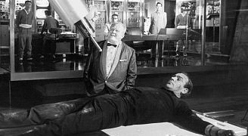
Hopefully he will not use Conventional RT without assessing other options…
Hopefully It is going to be SABR…
THANK YOU SO MUCH!
Notes:
BUT, PLEASE, INDIVIDUALISE AND THINK IN ARTT indivicualising in the classical palliative patient and in the patient with signs of progressive cancer.

Slide 20
Stereotactic Ablative Radiotherapy (SABR/SBRT)
2nd GC SABR Contouring Workshop.
18th April 2020.
Dr Luis AZNAR-GARCÍA
Clinical Oncologist Consultant
Brain Mets MDT and SRS Lead Clinician
SABR Oligometastases
Honorary (Consultant) Assistant Professor.
Nottingham University Hospitals
GENESIS CARE UK SABR REFERENCE GROUP and SRS LEAD CLINICIAN

